Slide 1


Heart Disease Prediction Using Machine Learning Create API using FLASK and Deploy on AWS
BY
SANKET SHETE

Slide 2
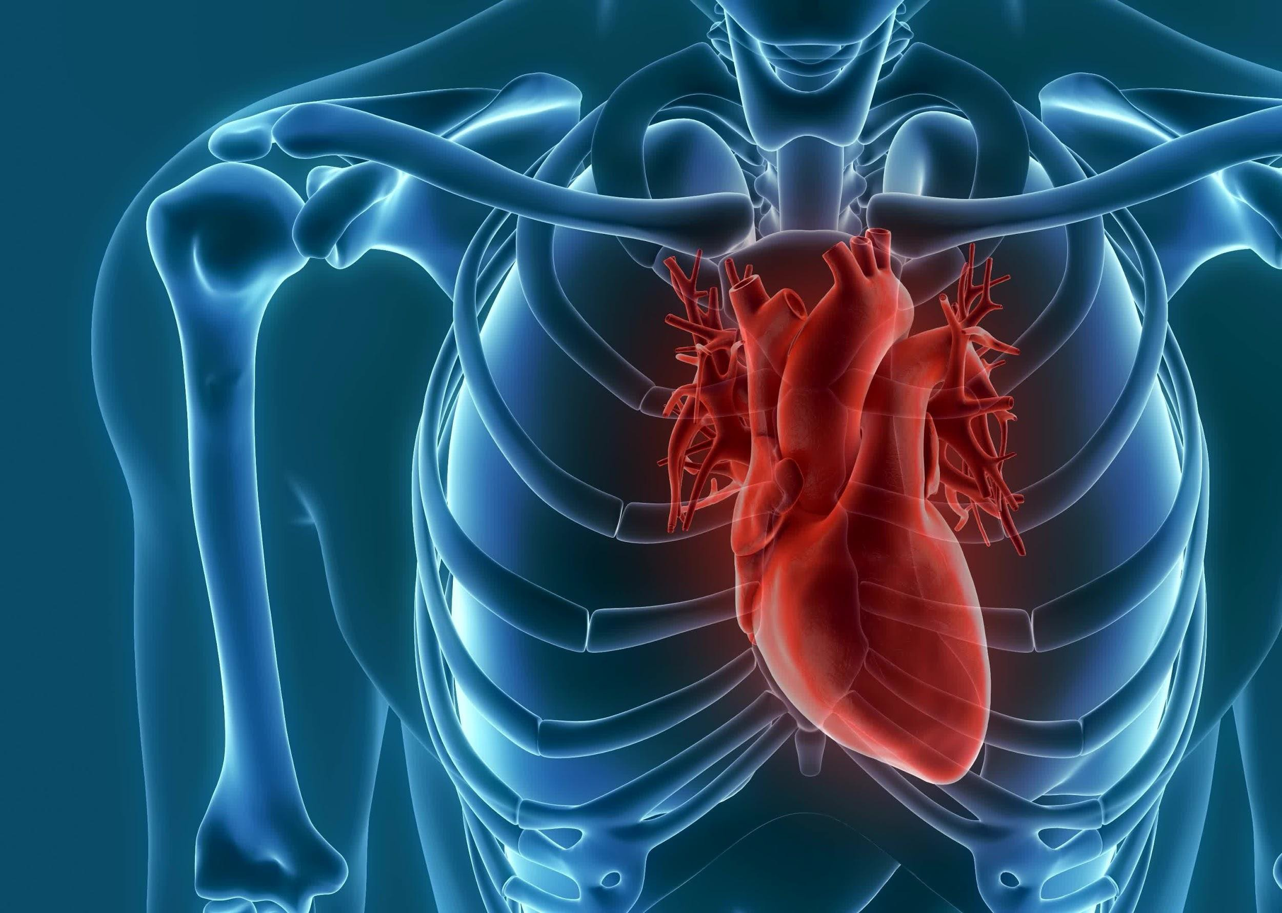

The Working of the Project

Slide 3
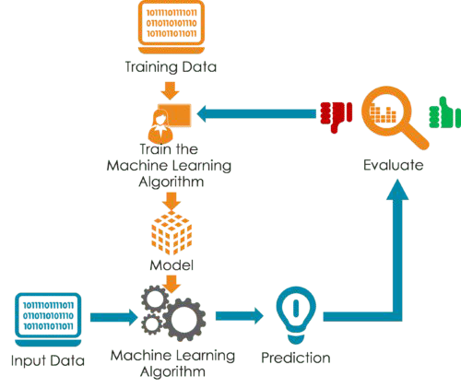
1.Problem statement
2.Data Gathering
3.Date preprocessing
4.Feature Engineering
5.Feature Selection
6.Moel Trainaing
7.Model Evaluation
8.Web development framework (flask)
9.Deployment on clod
(AWS)
LogisticRegression

Slide 4

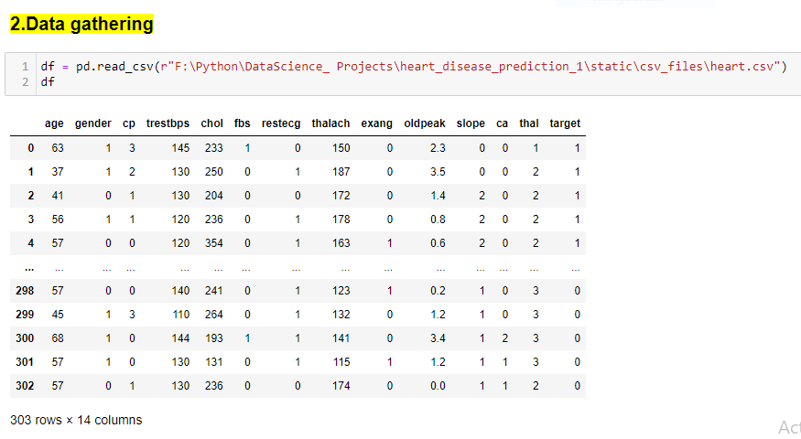

dataset

Slide 5
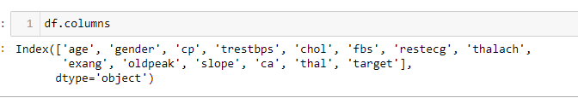
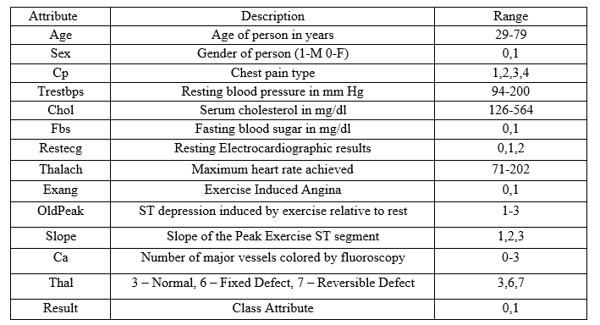

Slide 6
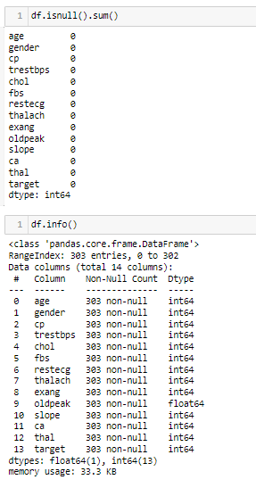
3.Data Preprocessing (EDA)
Dataset does not contain any missing value.
As dataset Dtype is numerical there is no need to done encoding.

Slide 7
4.Feature Engineering
Correlation matrix:
The correlation matrix, obtained using df.corr, provides a numeric representation of the relationships between variables. It helps identify the strength and direction of correlations between each pair of variables, including the correlations between risk factors and heart disease. Positive correlations (values closer to +1) indicate a positive relationship, while negative correlations (values closer to -1) indicate an inverse relationship.
High VIF values suggest the presence of multicollinearity, indicating that certain independent variables are highly correlated with each other
VIF:

Slide 8
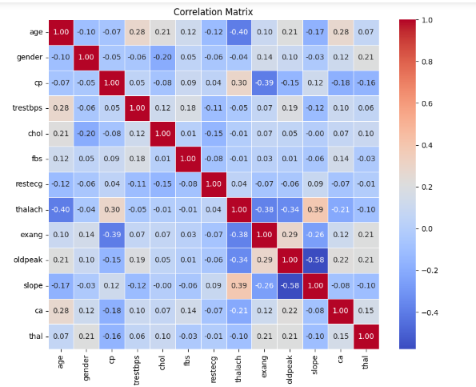
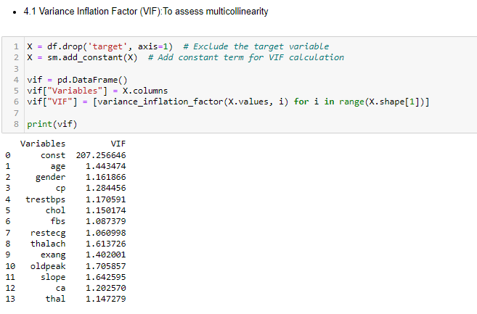

Slide 9
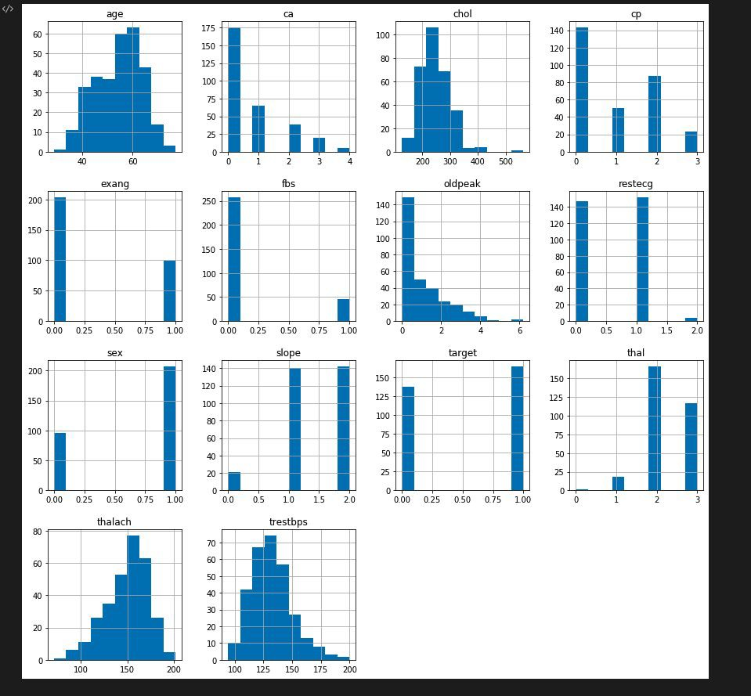
5.Data visualization

Slide 10

Three step process
Train the dataset
Evaluation
Split the dataset

Slide 11
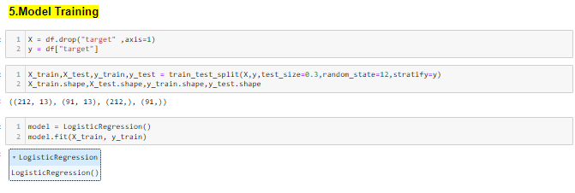
LogisticRegression

Slide 12
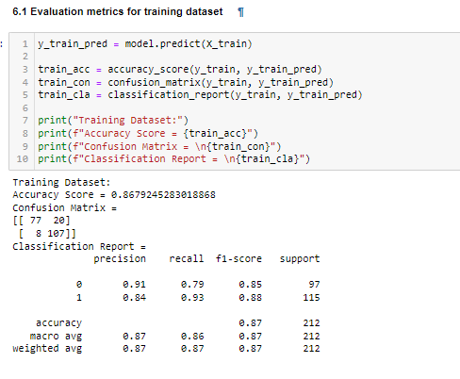
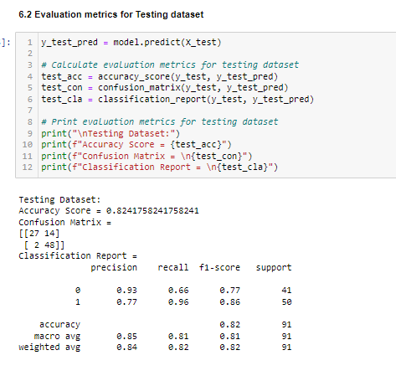
Model evaluation :
Training Accuracy = 0.86
Testing Accuracy = 0.82
Low bais && Low Varience

Slide 13
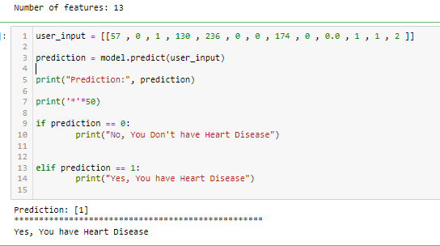
7.Test on a single row

Slide 14
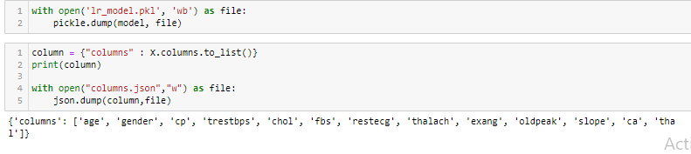
7.pickle and json files

Slide 15
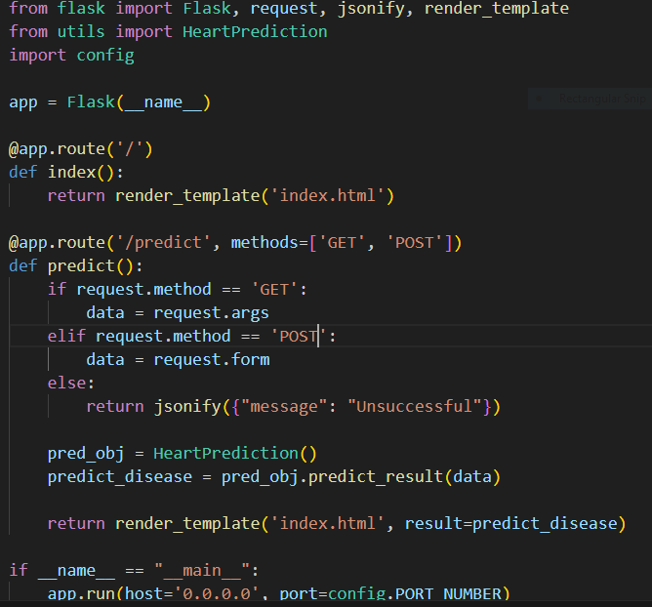
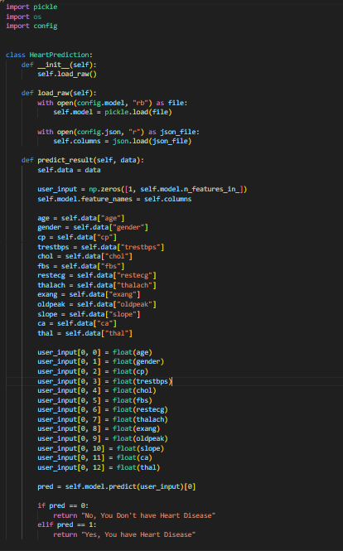
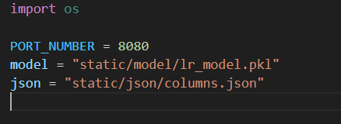
8.Web frame work :flask

Slide 16
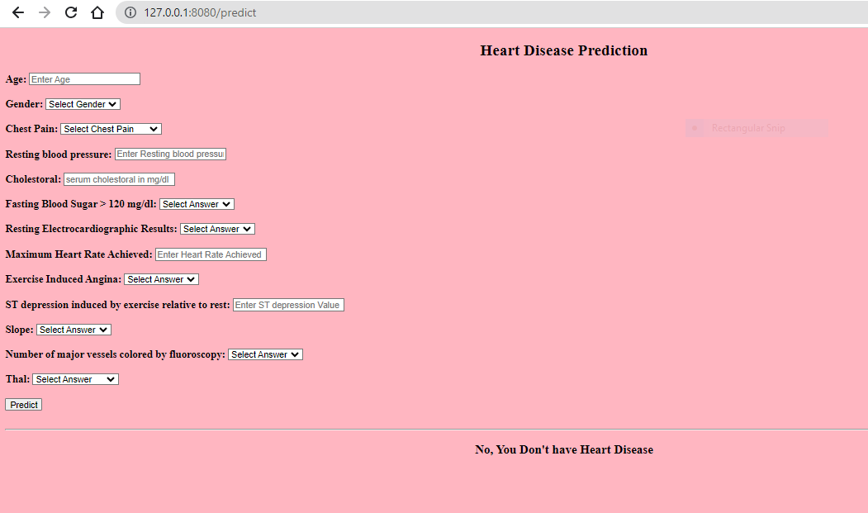
I had tested and run the application locally on my localhost

Slide 17
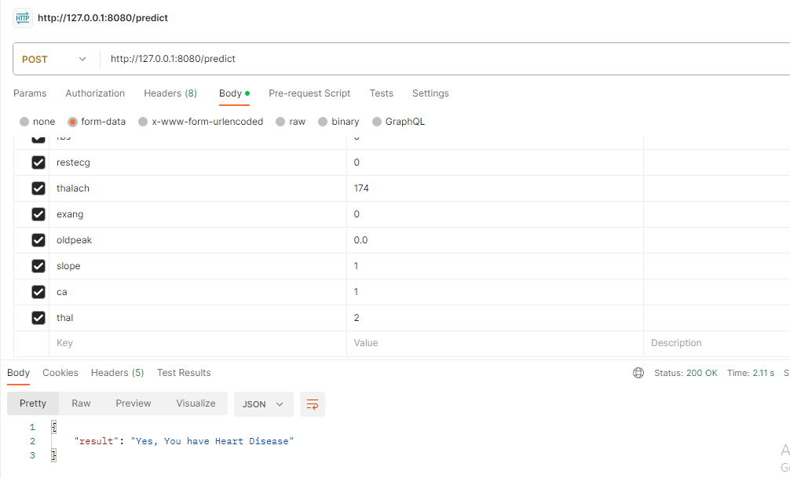
Testing the Heart Disease Prediction API :
To ensure the accuracy and functionality of the Heart Disease Prediction API, it is tested using a tool like Postman

Slide 18
The public IP address of the instance is
THANK YOU

